Slide 1


Automated Docker Security Remediation Pipeline
A fully automated approach to securing container images through continuous scanning and remediation.
by CodeZero Zero

Slide 2

Today's Containerization Security Challenges
Growing Attack Surface
Manual Remediation Bottlenecks
Container vulnerabilities exposing critical systems. New CVEs discovered daily.
Teams overwhelmed by vulnerability alerts. Slow response times to critical issues.
Compliance Requirements
Stringent security standards. Regular audits requiring documented processes.

Slide 3
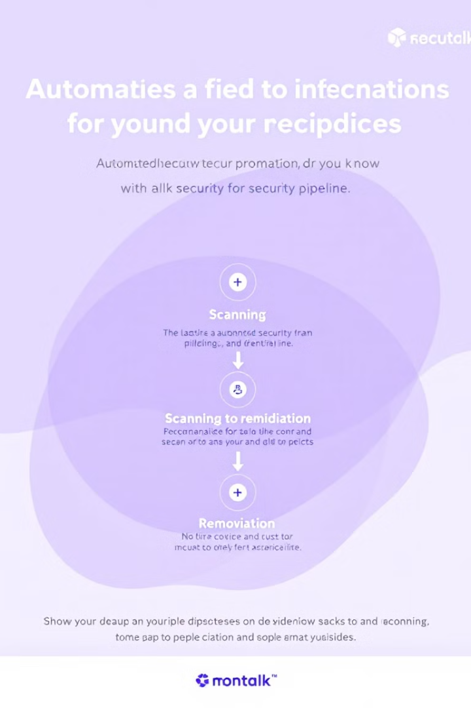




Pipeline Workflow Overview
Task Scheduled
Jenkins triggers automated security scanning.
Docker Image Scan
JFrog Xray performs CVE detection.
Automated Remediation
Security patches applied if vulnerabilities found.
Continuous Monitoring
Cycle repeats regularly for compliance.

Slide 4



Decision Logic
CVE Detected?
JFrog Xray analyzes scan results.
No: Continue Using Image
Clean image proceeds to deployment.
Yes: Remediation Process
Automated fix workflow begins.

Slide 5





Remediation Process
Identify Vulnerable Package
Scan report pinpoints exact vulnerability location.
Apply Security Patch
Update dependencies in Dockerfile.
Rebuild Docker Image
Jenkins triggers automated build process.
Validate Fixes
Re-scan image to confirm remediation.

Slide 6








Technology Stack
Jenkins
Docker
Orchestrates scheduled scanning and rebuilds.
Container images managed and rebuilt.
Git
JFrog Xray
Version control for Dockerfiles and patches.
Deep scanning for vulnerabilities.

Slide 7

Implementation Benefits
95%
87%
Reduced Manual Effort
Faster Response Time
Almost entirely hands-off remediation process.
Critical vulnerabilities addressed within hours.
100%
Compliance Coverage
Complete audit trail of security activities.

Slide 8

Next Steps
Implement Policy Controls
Integrate with SIEM
Add customizable block/allow decisions based on severity.
Expand Scanning Scope
Forward security events to central monitoring.
Include application dependencies beyond base images.

